Slide 1
Generative AI: A New Era of Creation
Exploring the landscape of AI-powered content generation

Slide 2
What is Generative AI?
Definition of Generative AI, its core functionalities, and how it differs from other forms of AI. Key concepts like machine learning models, training data, and output generation.

Slide 3
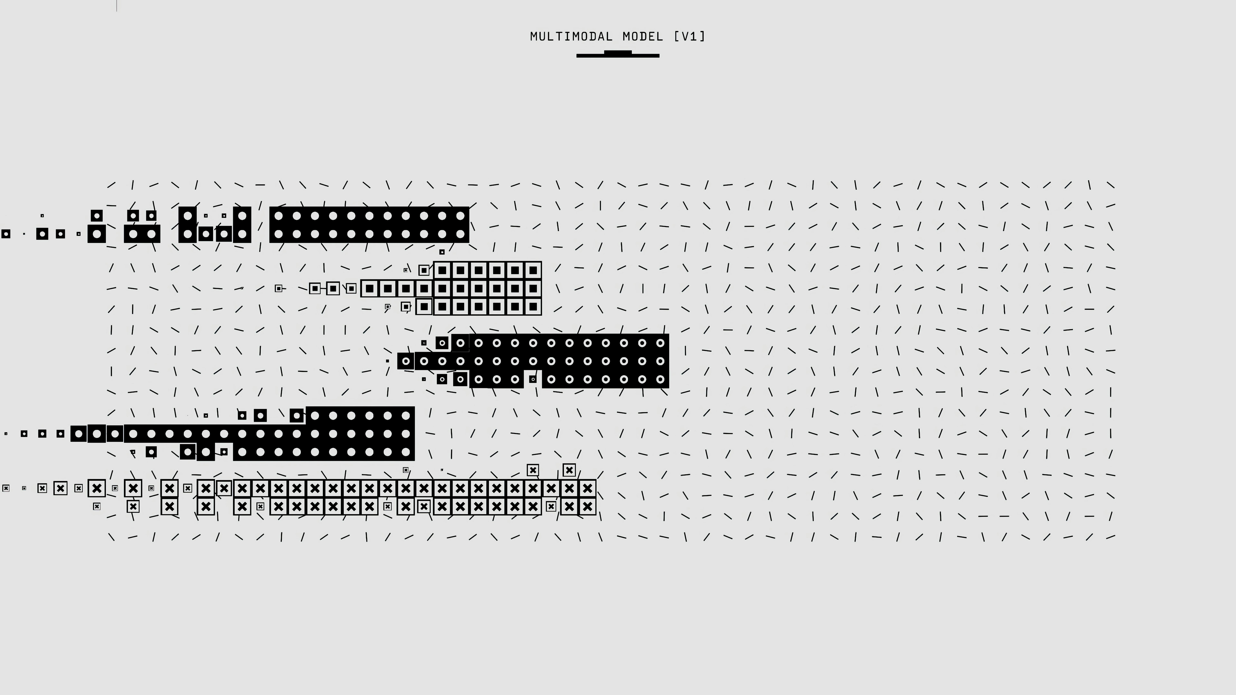
Types of Generative AI
Overview of different types like GANs, VAEs, and Transformers. Brief explanation of how each works and its common applications.

Slide 4
Text Generation
Examples and use cases of AI writing tools, code generation, scriptwriting, and chatbots. Discussion on the potential impact on various industries.

Slide 5

Image Generation
Showcasing AI-generated art, image editing capabilities, and applications in design and advertising. Include examples of AI-generated images.

Slide 6
Audio & Music Generation
Exploring AI's role in composing music, generating sound effects, voice cloning, and its potential for personalized audio experiences.

Slide 7
Video Generation
Discussion on AI's capability to generate and manipulate videos, create deepfakes, and its implications for the film and entertainment industry.

Slide 8

Ethical Considerations
Addressing concerns about copyright, misinformation, job displacement, and bias in Generative AI. Importance of responsible development and deployment.

Slide 9
The Future of Generative AI
Speculations about future advancements, potential applications across various fields, and the evolving relationship between humans and AI.

Slide 10
Thank You

